Slide 1
Social Media App Project
Roll no: 23-ntu-cs-1059
Roll no: 23-ntu-cs-1068
Roll no: 23-ntu-cs-1072

Slide 2
Objective: To develop a comprehensive social media platform implementing key social media functionalities with a robust database backend. Project Overview: Our social media app aims to provide a platform for users to interact by creating profiles, making posts, commenting, reacting, and managing friendships.

Slide 3
Business Rules User Registration: Each user can only have one profile. User Profiles: Users and pages can create posts. Posts can contain text content and are timestamped. Users can like and comment on posts. Pages: Only registered users can create pages. Each page must have a unique name. Pages display posts made by the page and list followers. Posts: Users must register with a unique username. Comments: Only registered users can comment on posts. Comments must be attributed to the commenting user. Reactions: Users can react to posts and comments with predefined reaction types (like, love, etc.).

Slide 4
Classes: DatabaseConnection Class: GetConnection PostsClass: GetUserPosts CreateNewPosts ClearPost GetPostId GetUserID CommentsClass: AddComment GetComments ClearComments

Slide 5
ReactionsClass: AddReaction GetReactions ClearReactions FriendshipClass: AddFriend RemoveFriend GetFriends PostUtils Class: AddPostToPanel

Slide 6
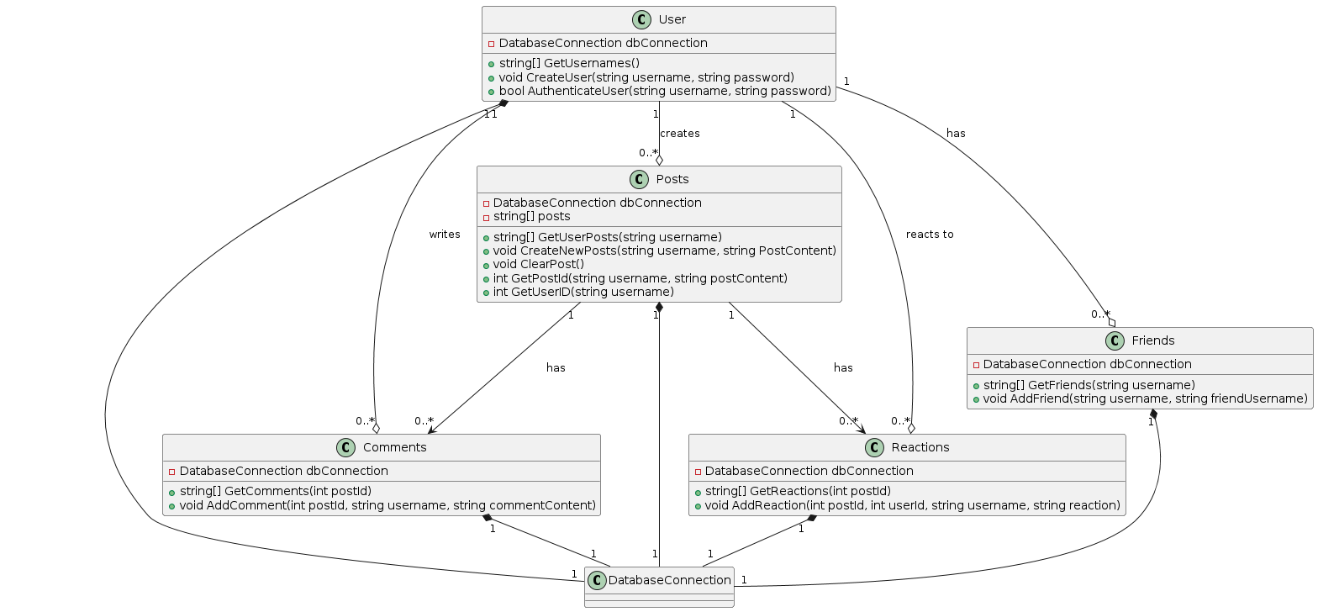
Class Diagram:

Slide 7
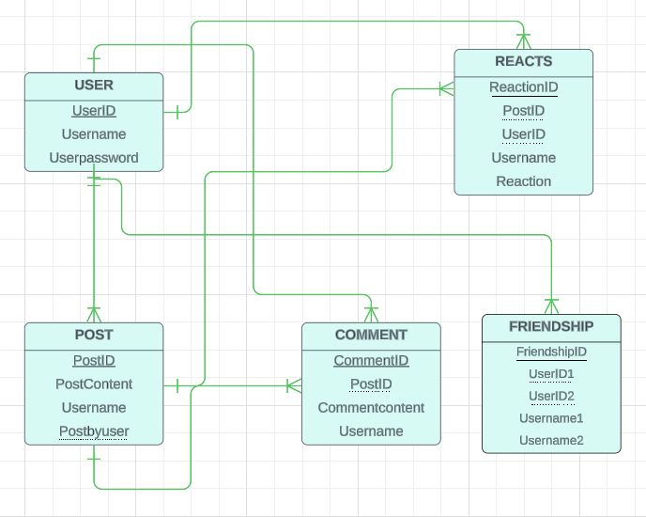
ER Diagram:

